Slide 1




.
Inspiring students to do more

Slide 2
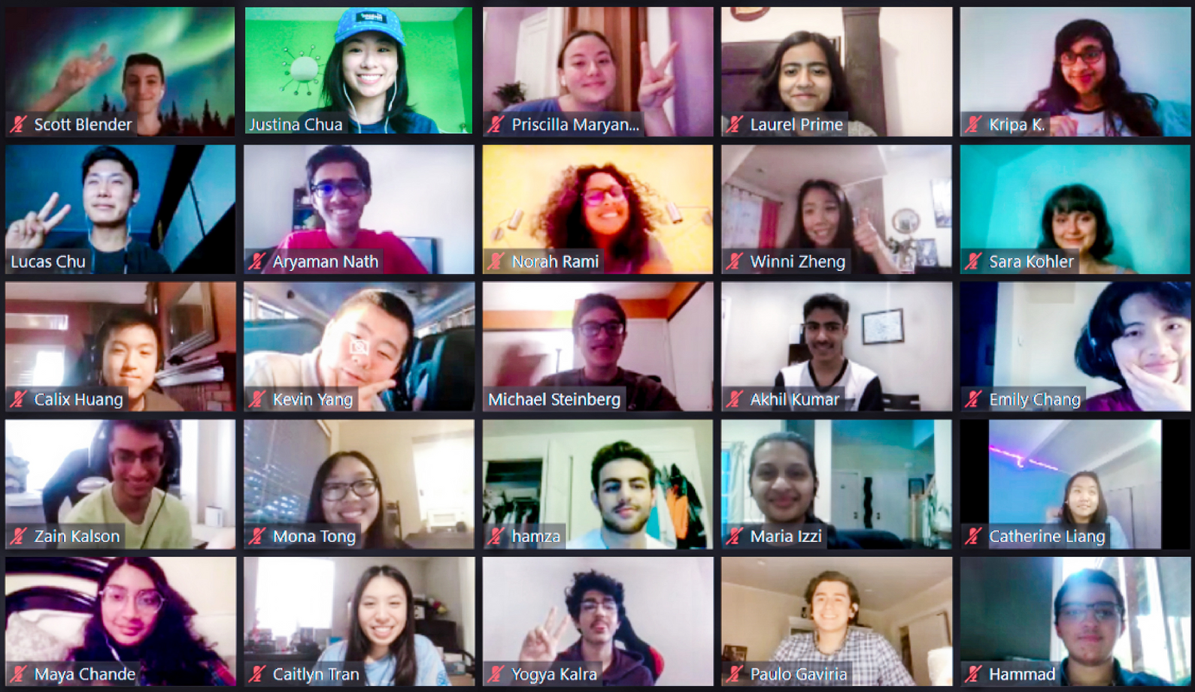

Our Mission
By connecting students around the world, we are unleashing potential and creating a unique research environment to foster new and innovative ideas.

Slide 3
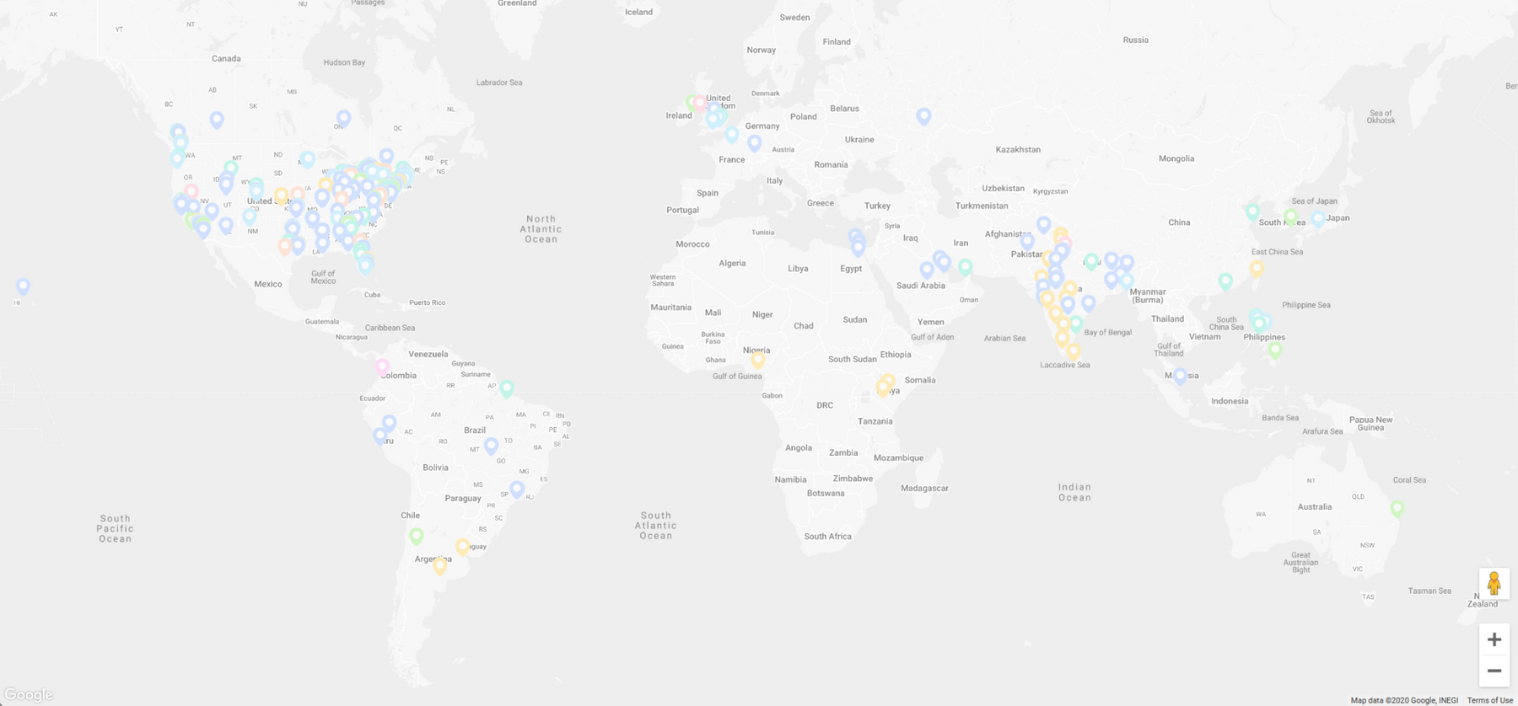
Who We Are
A wholesome and inclusive nonprofit of over 6,000 students across 20+ countries.

Slide 4
How We Do It
We seek to inspire and help student innovators pursue their ideas through the following core parts to our organization:
Incubation
1
We provide structure, passionate students in our network, and a collection of resources for students to pursue ideas, projects, or independent research studies.
Research
2
We focus on making research more equitable and accessible for students by providing them with opportunities to conduct independent research to discover solutions and connect with relevant academic organizations and faculty.
Community
3
We support projects and initiatives with connections, provide advice and assistance, and seek to ensure all of our work can see actionable results and implementation.

Slide 5









Our Initiatives
Partners
20+ Harvard Organizations, including
-Center for Geographic Analysis
-Data Science Initiative
-Innovation Labs
-Voters Choose
-Edmond J. Safra Center for Ethics
20+ Non-profits, including
-Mass General Hospital (S&SI)
-SimplyNeuroscience
-Dcyphr
-International Public Policy Association
-the WHO
Governmental Institutions, like
-Census Open Innovation Labs
-Consulate General of Canada in Boston
Intercollegiate
Discord

Slide 6

  200+ active members across various projects
  Coordinated the donation of 350k+ articles of PPE through SupplyCrate
  Featured on NBC29 on our EPA Fact-Checking project
  Created visualizations to inform NYC Borough Presidents and helped coordinate $600k in PPE donations
  Presented research to government leaders from the United Nations, European Union, and African Union

Slide 7
  1k+ members learning more about data visualizations
  Built a data visualization learning course with over 300 hundred students
  Hosted over 500 minutes of recorded content on data visualization from student leaders and experts
  Incubated various small projects in coordination with JOGL (Just One Giant Lab)
  Students completed literature views and presentations

Slide 8
  Regularly host speaker sessions
  Previous featured speakers:
    Grant Sanderson, mathematics content creator with over 100 million views
    Avi Schiffmann, informed over 1.5 billion people with COVID-19 statistics
    Dr. Francesca Dominici, ranked in the top 1% of cited scientists in her field and covered by CNN, BBC, NPR, and the New York Times

Slide 9
  700+ attendees at our first event and $20,000 in prizes
  Solutions engineered based on economic, political, sociocultural, and environmental issues
  Partnered with organizations such as Google Cloud, Discord, and Hack+
  Sponsored by 10+ different organizations
  Currently focused on starting a seed fund to support winning hackathon projects down the line

Slide 10
Works In-progress
Intercollegiate
Discord

Slide 11

Our Value
We seek to make an impact through student-led innovation. Our value lies within the success we have in helping students transition their ideation and implementing it into real-world impactful solutions (i.e data visualizations, research briefs, policy proposals, etc.).

Slide 12
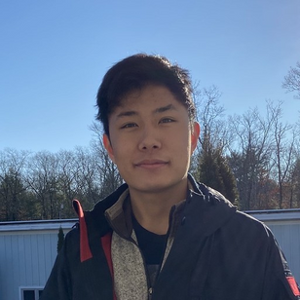
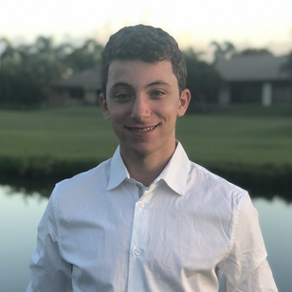
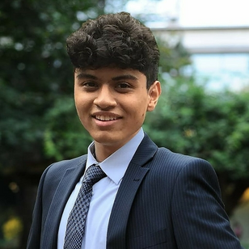
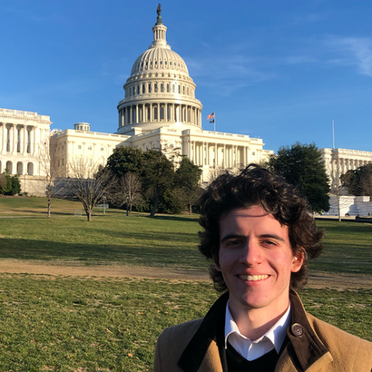
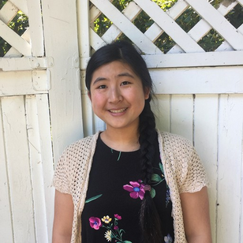
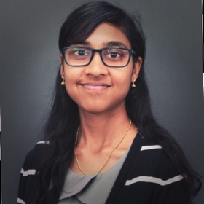
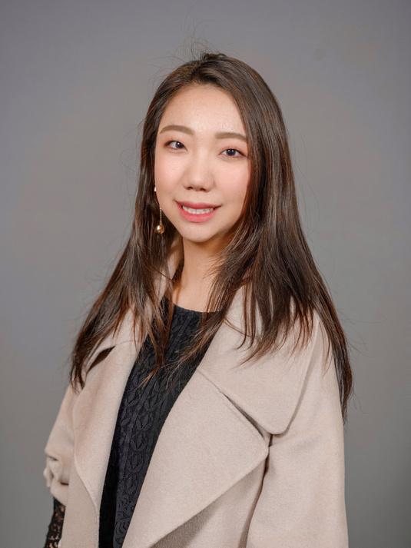

Board of Directors
Lucas Chu
Scott Blender
Zia Baig
CEO
COO
CFO
Marco Antonio
Serene Feng
Srikripa Krishnan
Winni Zheng
President of the Board
1st Vice President of the Board
2nd Vice President of the Board
Board of Directors Member

Slide 13

Learn More & Join Us
  Visit our website at https://projects.iq.harvard.edu/erevna.
  Reach out to info@understandcovid.org with any further questions.
  We have openings!!

